Slide 1

Parallelization of Floyd's Algorithm
Savitribai Phule Pune University
K. K. Wagh Institute of Engineering Education and Research, Nashik
Department of Computer Engineering
Prof- J.R.Mankar
Nikhil Wagh-29
Prathamesh Bhavsar-30
Faiz Shaikh-31
Pratik Kadale-32

Slide 2
Content:
Floyd's Algorithm.
Parallel Formulation of Floyd's Algorithm.
performance analysis.

Slide 3
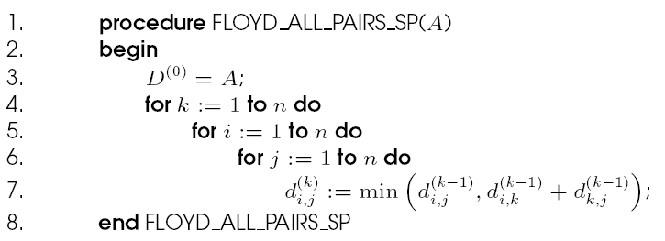
Floyd's Algorithm:
Floyd’s algorithm finds shortest path from every vertex in a graph to every other vertex in the graph, if such paths exist.
This program computes the all-pairs shortest paths of the graph G = (V,E) with adjacency matrix A.

Slide 4
Floyd's Algorithm: Parallel Formulation Using 2-D Block Mapping
The basic idea to parallelize the algorithm is to partition the matrix and split the computation between the processes.
Each process is assigned a specific part of the matrix.
Common way to achieve this is 2-D Block Mapping. Here the matrix is partitioned into squares of same size and each square gets assigned to a process.

Slide 5
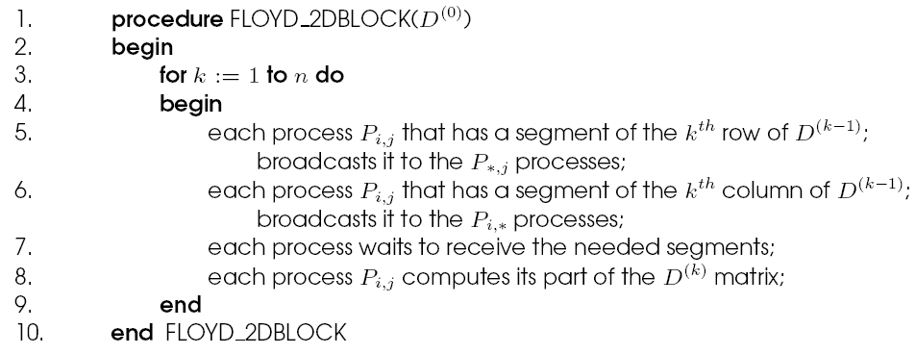
Parallelization of Floyd's Algorithm:
Floyd's parallel formulation using the 2-D block mapping. P_{*,j} denotes all the processes in the j^{th} column, and Pi,* denotes all the processes in the i^{th} row. The matrix D⁽⁰⁾ is the adjacency matrix.

Slide 6
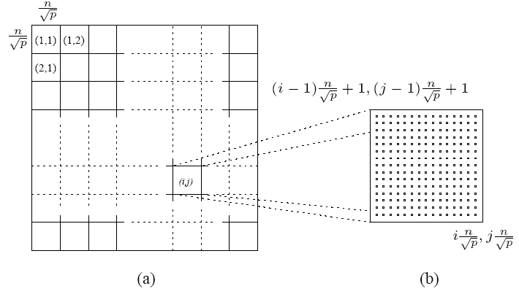
Floyd's Algorithm: Parallel Formulation Using 2-D Block Mapping
(a) Matrix D^{(k)} distributed by 2-D block mapping into √p x √p subblocks, and (b) the subblock of D^{(k)} assigned to process P_{i,j}.

Slide 7
Floyd's Algorithm: Parallel Formulation Using 2-D Block Mapping
Matrix D(k) is divided into p blocks of size (n / √p) x (n / √p).
Each processor updates its part of the matrix during each iteration.
To compute dl(,kk-1) processor Pi,j must get dl(,kk-1) and dk(,kr-1).
In general, during the kth iteration, each of the √p processes containing part of the kth row send it to the √p - 1 processes in the same column.
Similarly, each of the √p processes containing part of the kth column sends it to the √p - 1 processes in the same row.

Slide 8
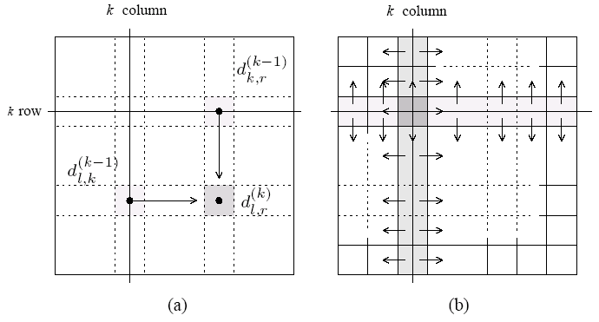
Floyd's Algorithm: Parallel Formulation Using 2-D Block Mapping
(a) Communication patterns used in the 2-D block mapping. When computing d_{i}⁽,^{k}_{j}⁾, information must be sent to the highlighted process from two other processes along the same row and column. (b) The row and column of √p processes that contain the k^{th} row and column send them along process columns and rows.

Slide 9
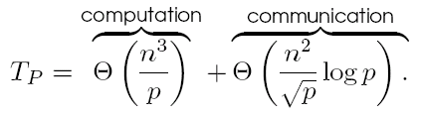
performance analysis :
During each iteration of the algorithm, the k^{th} row and k^{th} column of processors perform a one-to-all broadcast along their rows/columns.
The size of this broadcast is n/√p elements, taking time Θ((n log p)/ √p).
The synchronization step takes time Θ(log p).
The computation time is Θ(n²/p).
The parallel run time of the 2-D block mapping formulation of Floyd's algorithm is

Slide 10
The above formulation can use O(n² / log² n) processors cost-optimally.
The isoefficiency of this formulation is Θ(p^{1.5} log³ p).

